Slide 1
GRADE 7 ACCELERATED · UNIT 6 · LESSON 3
Pythagorean Theorem
MA.8.GR.1.1
I can find a missing side of a right triangle — the hypotenuse, or a leg.
Grade 7 Accelerated · Unit 6 · Lesson 3 — Pythagorean Theorem
1

Slide 2


Warm-Up
1. Can sides of 4 in, 7 in and 12 in make a triangle?
2. A printer prints 18 pages a minute. Pages in 4.5 minutes?
3. Find the value:
4. Find the value:
Grade 7 Accelerated · Unit 6 · Lesson 3 — Pythagorean Theorem
2

Slide 3
Warm-Up
1. Can sides of 4 in, 7 in and 12 in make a triangle?
No — 4 + 7 = 11 < 12
2. A printer prints 18 pages a minute. Pages in 4.5 minutes?
81 pages
3. Find the value:
14
4. Find the value:
64
Grade 7 Accelerated · Unit 6 · Lesson 3 — Pythagorean Theorem
3

Slide 4

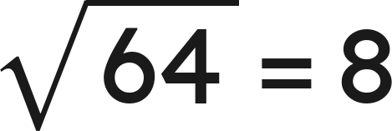
Vocabulary
Pythagorean Theorem
in every right triangle, leg² + leg² = hypotenuse²:
hypotenuse
c — the side across from the right angle, always the longest side
square root
the number that, times itself,
makes the number under the root sign:
Grade 7 Accelerated · Unit 6 · Lesson 3 — Pythagorean Theorem
4

Slide 5
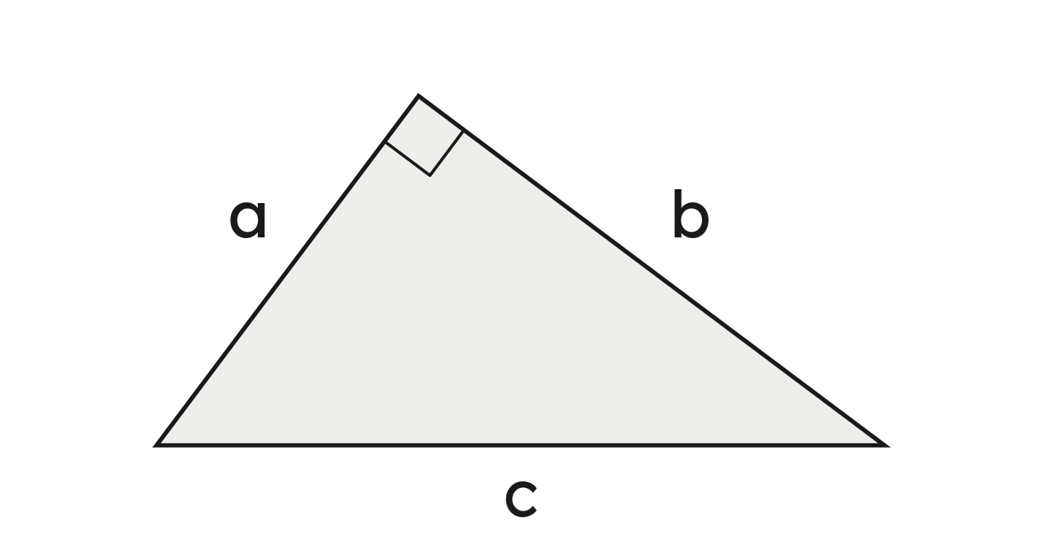

Notes
I. The square corner first; c is across from it
The legs' squares add up to the hypotenuse's square. c is across from the right angle — always the longest side.
Grade 7 Accelerated · Unit 6 · Lesson 3 — Pythagorean Theorem
5

Slide 6
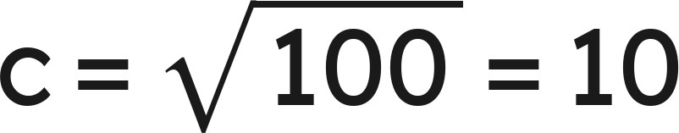

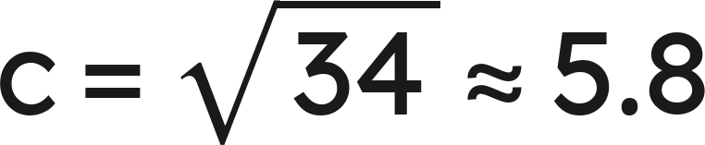
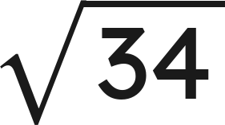
Notes
II. The hypotenuse: square, add, then the root
Legs 3 and 5:
,
Exact:
. To the nearest tenth: 5.8.
Grade 7 Accelerated · Unit 6 · Lesson 3 — Pythagorean Theorem
6

Slide 7


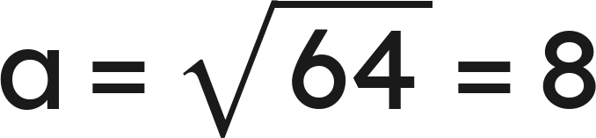

Notes
III. A leg: subtract the squares
For a leg, subtract:
.
Check: a leg is shorter than the hypotenuse.
Grade 7 Accelerated · Unit 6 · Lesson 3 — Pythagorean Theorem
7

Slide 8
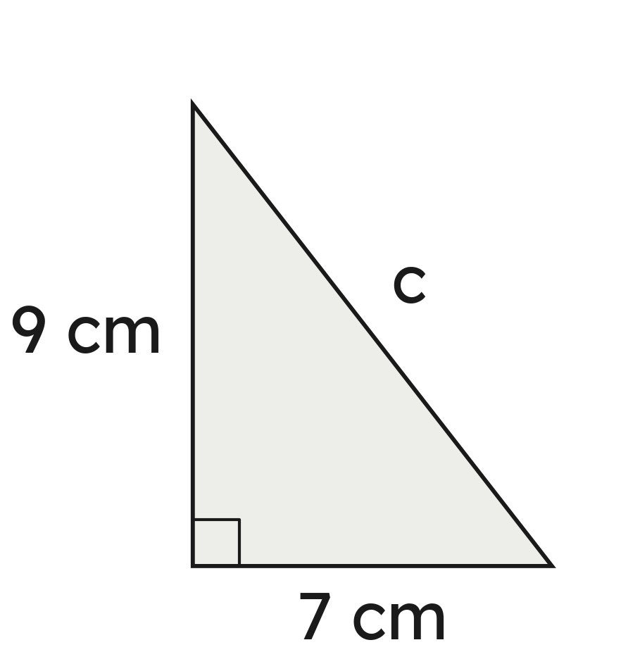
Example 1
A right triangle has legs of 7 cm and 9 cm.
How long is the hypotenuse? Give it exactly and to the nearest tenth.
Grade 7 Accelerated · Unit 6 · Lesson 3 — Pythagorean Theorem
8

Slide 9
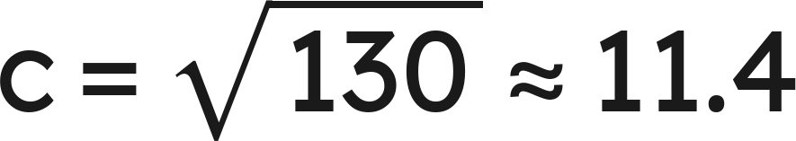
Example 1
Answer: c = √130 cm ≈ 11.4 cm
Grade 7 Accelerated · Unit 6 · Lesson 3 — Pythagorean Theorem
9

Slide 10
Your Turn
A right triangle has legs of 5 in and 11 in.
How long is the hypotenuse, exactly and to the nearest tenth?
Grade 7 Accelerated · Unit 6 · Lesson 3 — Pythagorean Theorem
10

Slide 11

Your Turn
A right triangle has legs of 5 in and 11 in.
How long is the hypotenuse, exactly and to the nearest tenth?
Answer: c = √146 in ≈ 12.1 in
Grade 7 Accelerated · Unit 6 · Lesson 3 — Pythagorean Theorem
11

Slide 12
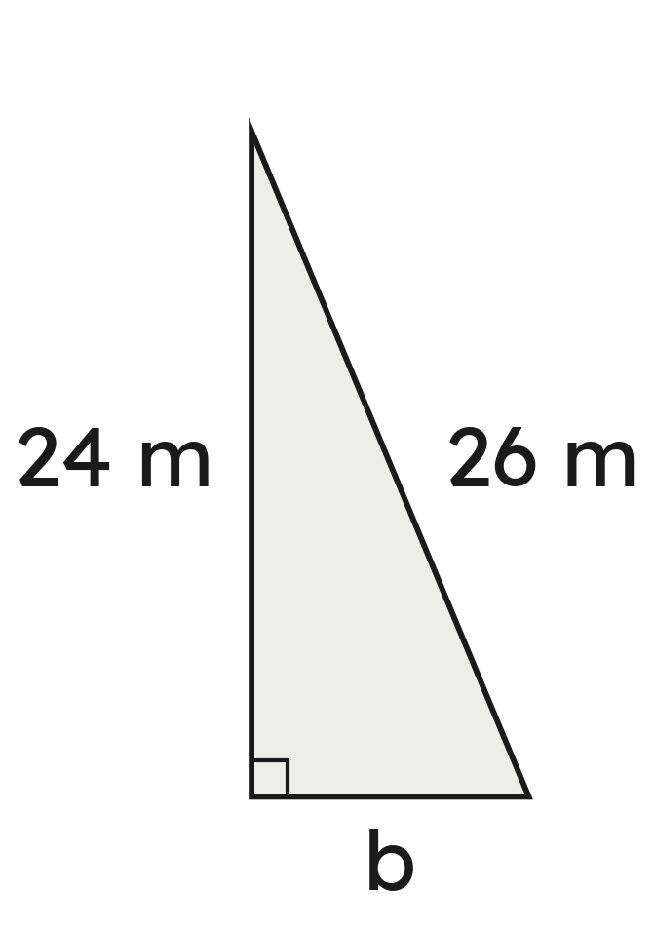
Example 2
A right triangle has a hypotenuse of 26 m and one leg of 24 m.
How long is the other leg?
Grade 7 Accelerated · Unit 6 · Lesson 3 — Pythagorean Theorem
12

Slide 13

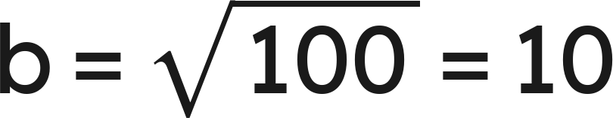
Example 2
Answer: b = 10 m
Grade 7 Accelerated · Unit 6 · Lesson 3 — Pythagorean Theorem
13

Slide 14
Your Turn
A right triangle has a hypotenuse of 11 ft and one leg of 6 ft.
How long is the other leg, exactly and to the nearest tenth?
Grade 7 Accelerated · Unit 6 · Lesson 3 — Pythagorean Theorem
14

Slide 15

Your Turn
A right triangle has a hypotenuse of 11 ft and one leg of 6 ft.
How long is the other leg, exactly and to the nearest tenth?
Answer: b = √85 ft ≈ 9.2 ft
Grade 7 Accelerated · Unit 6 · Lesson 3 — Pythagorean Theorem
15

Slide 16
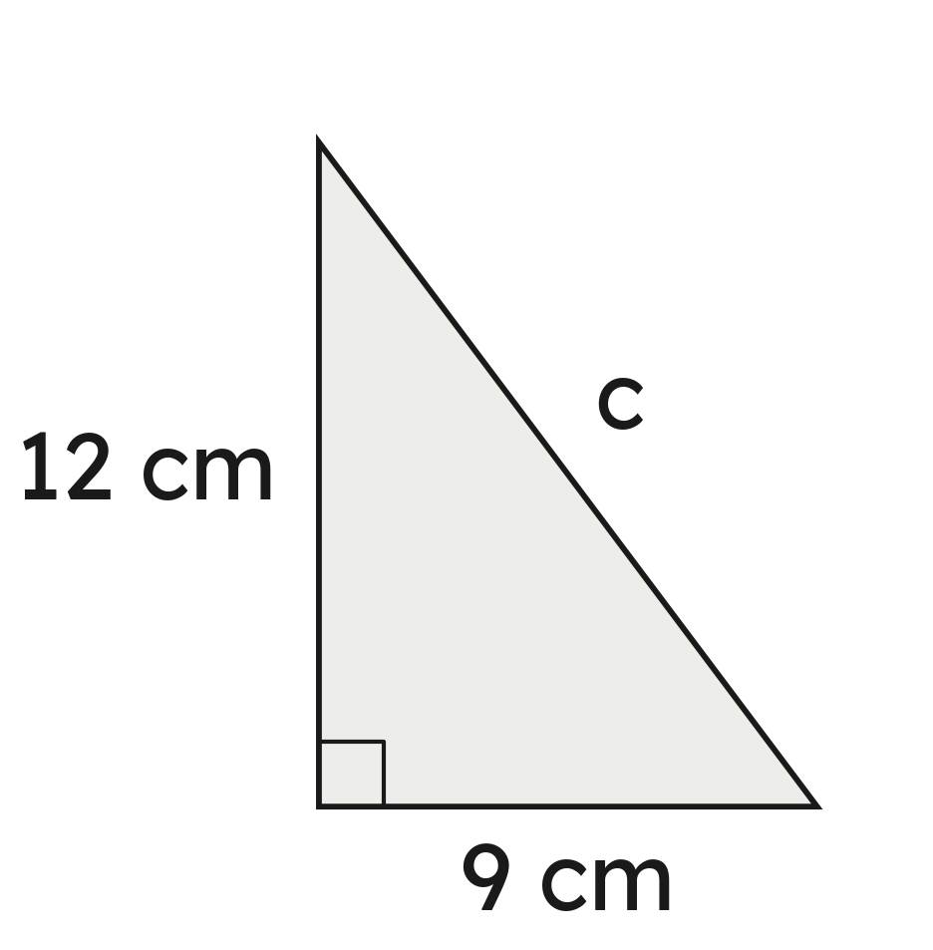
Whiteboards · Question 1 of 9
A right triangle has legs of 9 cm and 12 cm.
How long is the hypotenuse?
Answer it.
Grade 7 Accelerated · Unit 6 · Lesson 3 — Pythagorean Theorem
16

Slide 17

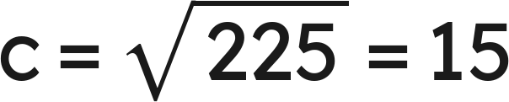
Whiteboards · Question 1 of 9
A right triangle has legs of 9 cm and 12 cm.
How long is the hypotenuse?
Answer: 15 cm
Grade 7 Accelerated · Unit 6 · Lesson 3 — Pythagorean Theorem
17

Slide 18
Whiteboards · Question 2 of 9
A right triangle has legs of 4 in and 9 in.
How long is the hypotenuse, to the nearest tenth?
Answer it.
Grade 7 Accelerated · Unit 6 · Lesson 3 — Pythagorean Theorem
18

Slide 19

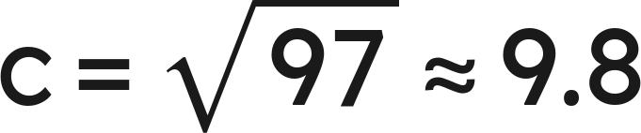
Whiteboards · Question 2 of 9
A right triangle has legs of 4 in and 9 in.
How long is the hypotenuse, to the nearest tenth?
Answer: √97 in ≈ 9.8 in
Grade 7 Accelerated · Unit 6 · Lesson 3 — Pythagorean Theorem
19

Slide 20
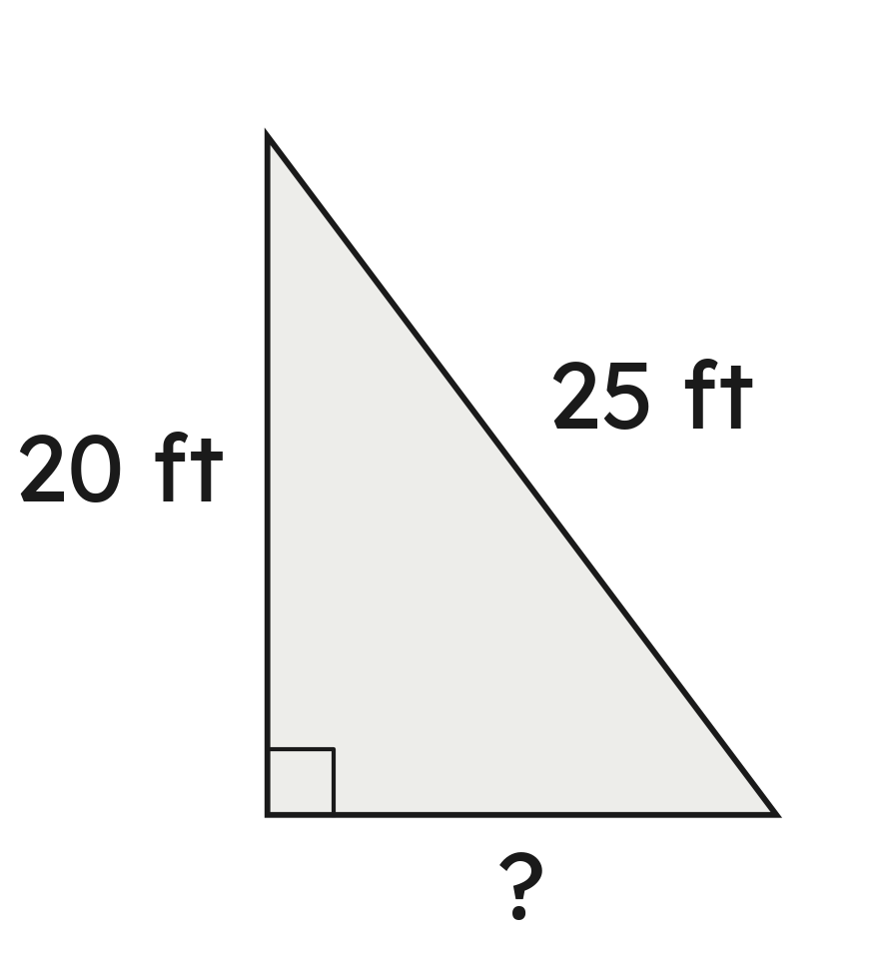
Whiteboards · Question 3 of 9
A right triangle has a hypotenuse of 25 ft and one leg of 20 ft.
How long is the other leg?
Answer it.
Grade 7 Accelerated · Unit 6 · Lesson 3 — Pythagorean Theorem
20

Slide 21
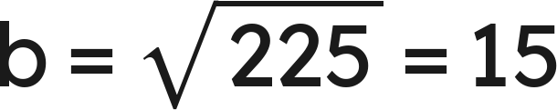
Whiteboards · Question 3 of 9
A right triangle has a hypotenuse of 25 ft and one leg of 20 ft.
How long is the other leg?
Answer: 15 ft
Grade 7 Accelerated · Unit 6 · Lesson 3 — Pythagorean Theorem
21

Slide 22
Whiteboards · Question 4 of 9
A right triangle has a hypotenuse of 41 m and one leg of 40 m.
How long is the other leg?
A. 9 m
B. 81 m
C. 1 m
D. 57.3 m
Answer it.
Grade 7 Accelerated · Unit 6 · Lesson 3 — Pythagorean Theorem
22

Slide 23

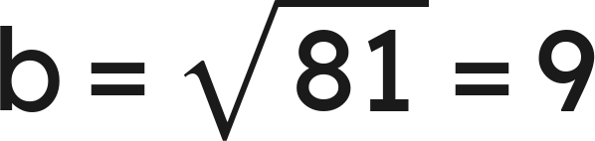
Whiteboards · Question 4 of 9
A right triangle has a hypotenuse of 41 m and one leg of 40 m.
How long is the other leg?
Answer: A — 9 m
Grade 7 Accelerated · Unit 6 · Lesson 3 — Pythagorean Theorem
23

Slide 24
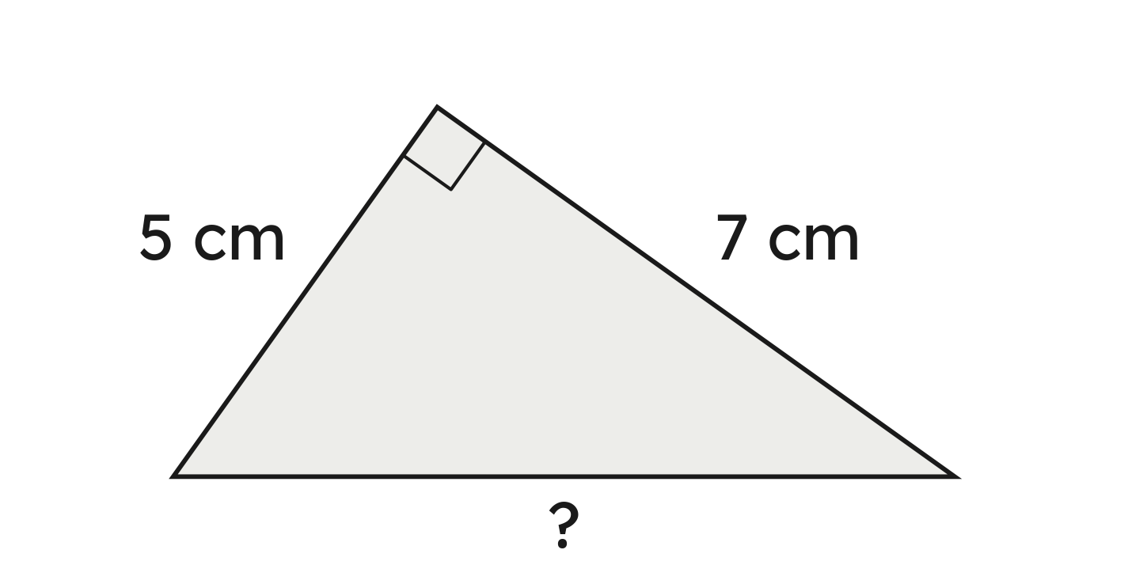
Whiteboards · Question 5 of 9
The right triangle is drawn turned. Its legs are 5 cm and 7 cm.
How long is the hypotenuse, to the nearest tenth?
Answer it.
Grade 7 Accelerated · Unit 6 · Lesson 3 — Pythagorean Theorem
24

Slide 25

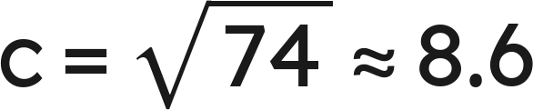
Whiteboards · Question 5 of 9
The right triangle is drawn turned. Its legs are 5 cm and 7 cm.
How long is the hypotenuse, to the nearest tenth?
Answer: √74 cm ≈ 8.6 cm
Grade 7 Accelerated · Unit 6 · Lesson 3 — Pythagorean Theorem
25

Slide 26



Whiteboards · Question 6 of 9
A right triangle's hypotenuse is 20 in; its legs are 16 in and x.
Which equation finds x?
A.
B.
C.
D.
Answer it.
Grade 7 Accelerated · Unit 6 · Lesson 3 — Pythagorean Theorem
26

Slide 27
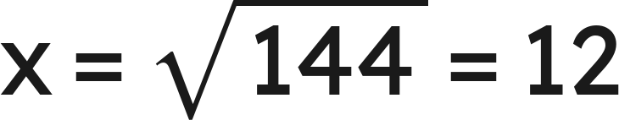
Whiteboards · Question 6 of 9
A right triangle's hypotenuse is 20 in; its legs are 16 in and x.
Which equation finds x?
Answer: D — and x = 12 in
Grade 7 Accelerated · Unit 6 · Lesson 3 — Pythagorean Theorem
27

Slide 28
Whiteboards · Question 7 of 9
A right triangle has a hypotenuse of 14 m and one leg of 9 m.
How long is the other leg, to the nearest tenth?
Answer it.
Grade 7 Accelerated · Unit 6 · Lesson 3 — Pythagorean Theorem
28

Slide 29

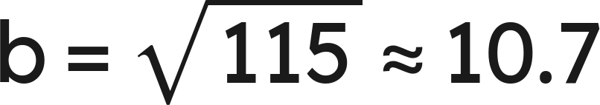
Whiteboards · Question 7 of 9
A right triangle has a hypotenuse of 14 m and one leg of 9 m.
How long is the other leg, to the nearest tenth?
Answer: √115 m ≈ 10.7 m
Grade 7 Accelerated · Unit 6 · Lesson 3 — Pythagorean Theorem
29

Slide 30
Whiteboards · Question 8 of 9
A pennant is cut as a right triangle with legs of 8 in and 11 in. The fabric costs 6 dollars.
How long is its longest side, to the nearest tenth?
Answer it.
Grade 7 Accelerated · Unit 6 · Lesson 3 — Pythagorean Theorem
30

Slide 31

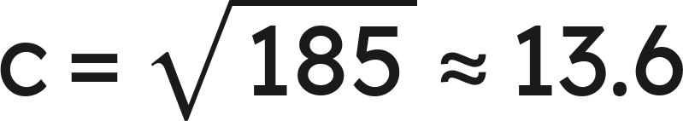
Whiteboards · Question 8 of 9
A pennant is cut as a right triangle with legs of 8 in and 11 in. The fabric costs 6 dollars.
How long is its longest side, to the nearest tenth?
Answer: √185 in ≈ 13.6 in
Grade 7 Accelerated · Unit 6 · Lesson 3 — Pythagorean Theorem
31

Slide 32
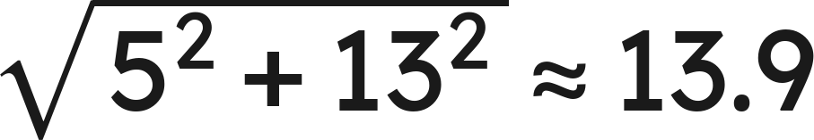
Whiteboards · Question 9 of 9
Jo finds a leg of a right triangle. The hypotenuse is 13 cm and the other leg is 5 cm.
She writes
.
What went wrong? How long is the leg?
Write your answer in sentences.
Grade 7 Accelerated · Unit 6 · Lesson 3 — Pythagorean Theorem
32

Slide 33
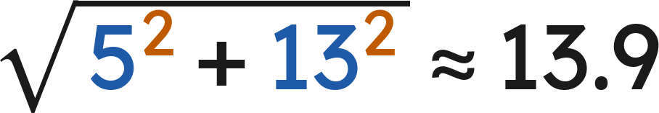

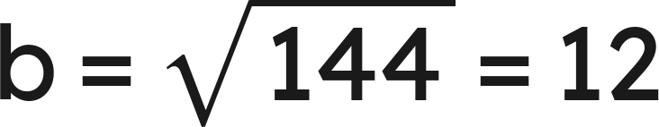
Whiteboards · Question 9 of 9
Jo finds a leg of a right triangle. The hypotenuse is 13 cm and the other leg is 5 cm.
She writes
.
What went wrong? How long is the leg?
Answer: She added the squares; a leg must be shorter than 13 cm. Subtract: the leg is 12 cm.
Grade 7 Accelerated · Unit 6 · Lesson 3 — Pythagorean Theorem
33

Slide 34
Independent Set
1.
A right triangle has legs of 12 m and 5 m. How long is the hypotenuse?
2.
A right triangle has legs of 3 ft and 8 ft. How long is the hypotenuse, exactly and to the nearest tenth?
3.
A right triangle has a hypotenuse of 39 cm and one leg of 36 cm. How long is the other leg?
4.
A right triangle has a hypotenuse of 11 in and one leg of 4 in. How long is the other leg, exactly and to the nearest tenth?
5.
A right triangle is drawn turned on its side. Its legs are 6 m and 11 m. How long is its hypotenuse, to the nearest tenth?
6.
A right triangle has a hypotenuse of 25 yd and one leg of 24 yd. The other leg is x. Write the equation that finds x, then find x.
Grade 7 Accelerated · Unit 6 · Lesson 3 — Pythagorean Theorem
34

Slide 35
IXL
1.
Open IXL and start today's skills.
2.
Work on paper where the question needs work. The answer box does not show it.
3.
Every skill listed is required, to a SmartScore of 67. Due at the start of the next class.
Today's skills — all required
Pythagorean theorem: find the missing leg or hypotenuse length — MTM
Grade 7 Accelerated · Unit 6 · Lesson 3 — Pythagorean Theorem
35

